Slide 1

Securing Your Cloud Applications with Identity and Private Networking Best Practices
Preventing the next “blizzard”!
Paul Yuknewicz (@paulyuki99)

Slide 2
In Today’s Session
Attack examples
Basic prevention in infrastructure
Passwordless deep dive using managed identity
Network isolation deep dive
Tips n tricks
Resources

Slide 3
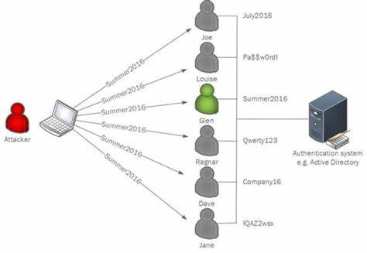
Midnight Blizzard Attack
Legacy & dev test servers, leverage passwords and service principals
Buying/finding account names online
Password spraying
OAuth app and admin misuse
Reading emails with more passwords, <repeat>
Midnight Blizzard: Guidance for responders on nation-state attack | Microsoft Security Blog
Protecting your organization against password spray attacks | Microsoft Security Blog

Slide 4

Basic Strategies – Part 0 - Infrastructure
Use modern, PATCHED servers!
Use latest secure SDKs, runtimes, etc
PaaS/managed services help
Secure supply chain / registries
Install only what you need
Limit access to absolute minimum
Separate servers by concern, e.g. dev, test, prod, docs, and *never mix workloads/assets (e.g. prod workload users on test, test scripts on prod)

Slide 5

Basic Strategies – Part 1 - Passwordless
Go Passwordless!
Identity based connections: Entra ID, Managed Identity, OIDC, more..
PassKey & FIDO keys
Turn off passwords
Delete service principals
Delete tokens/secrets from disk, code, env vars, everywhere..
Use MFA!
Never accept unrecognized request
If you must use password/token/secret, use Key Vault

Slide 6
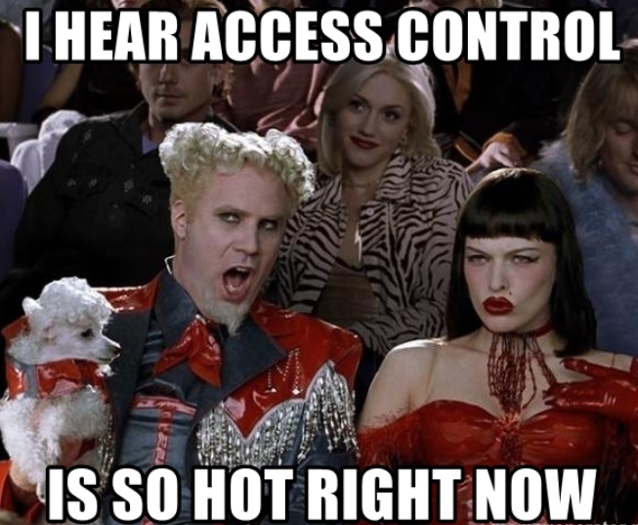
Basic strategies – Part 2 – Access Control
This is about RBAC or roles based access control
Restrict access levels to roles, and only grant the minimum
Review all access lists now, prune, refresh regularly
Avoid using any Full Control, Full Admin type roles
Beware of service principals – they still store the secret (identity and/or OIDC with managed identity always preferred)

Slide 7

Basic Strategies – Part 3 – Network Isolation
This is about fencing networks from threats
Apps & dependencies belong to VNET
App outbound traffic to dependencies uses private endpoint, optionally NAT
App inbound traffic uses an option to limit traffic (auth, vnet, allow lists)

Slide 8
new Azure Functions quick start samples
These samples are secure & scalable, they
demonstrate best practices in creating secure apps
include VNET integration
use Flex Consumption
use the Azure Developer CLI for easy deployment
https://aka.ms/functions-secure-samples

Slide 9
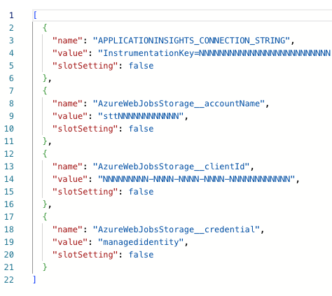
Identity Deeper Dive
Top places to use identity
Deployment package load (functions.zip)
AzureWebJobsStorage state management
SDKs/Triggers/bindings connections
Managed identity
System assigned or SAMI (quick)
User assigned or UAMI (durable, recommended for prod)
Default identity connection uses SAMI
ClientId, Credential, & URI/name (3 settings) always needed for UAMI
“conn__property” syntax for SDKs and bindings
IAM (RBAC) roles are then required to grant least access
Consider your app’s managed identity
Consider your own login identity
Example – identity based connection: Azure Service Bus trigger for Azure Functions | Microsoft Learn

Slide 10
Want to Follow Along?
https://aka.ms/functions-secure-samples
azd init --template functions-quickstart-dotnet-azd azd up

Slide 11
Demo
Implementing identity and network isolation (new app) Implementing … (existing app)

Slide 12
Network Isolation Overview
Inbound networking controls access to your app
Public network access can be either enabled or disabled
IP access restrictions
Service endpoints
Private endpoints
Outbound networking controls how connections are made
Virtual network integration
NSG Rules
UDRs
NAT Gateway
Notes:
Why care about networking?
Authentication restricts access to select users; networking restricts access to select devices. A dual approach to security.
Inbound
Restrict access to trusted IPs, which could be public IPs
Restrict access to Azure services that are in a vnet – aka, their source IP is from an Azure virtual network
Restrict access to machines with access to a specific IP address in your VNet
Outbound
Join your app to a virtual network to unlock inbound networking
Create custom rules to deny inbound/outbound traffic with NSG (network security group) rules
Control how traffic is routed (hopped) with UDRs (user defined routes)
Is outbound to this destination allowed (NSG)? If yes, how should it be routed there (UDR)?

Slide 13





Basic Network Security
HTTP Request / Response
Function app backend call
Virtual network
10.0.0.0/16
Public network access disabled
with one private endpoint connection
Virtual network
Integration
Subnet for VNet integration
- delegated to Microsoft.App/Environments
- 10.0.1.0/24
Subnet for private endpoints
- 10.0.2.0/24
App accessible over the internet
Private endpoint to storage
10.0.2.1
Azure Blob
Storage
Trigger app from client
Azure Private
DNS Zone

Slide 14
Network Isolation Deeper Dive
App inbound traffic uses an option:
VNET (most secure, but limiting public access)
Trusted IPs
Auth method (e.g. Easy Auth and authorization list)
Recommend turning off public access by default, opt in if really desired
Use Azure Front Door and Defender to protect and managed inbound traffic
App outbound
Joins vnet
Private service endpoints
NAT
Service tag to identity customer/tenant

Slide 15
Demo
Network isolation part 2

Slide 16
Resources
Create functions in Azure using the Azure Developer CLI | Microsoft Learn – secure by design quickstarts
Security - Azure App Service | Microsoft Learn – app service
Securing Azure Functions | Microsoft Learn – functions
@paulyuki99 when all else fails

